Slide 1
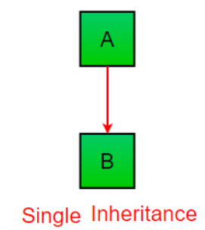
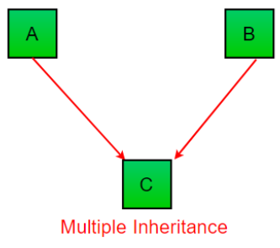
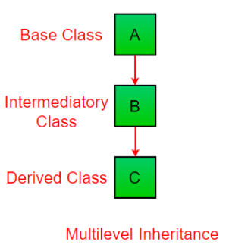
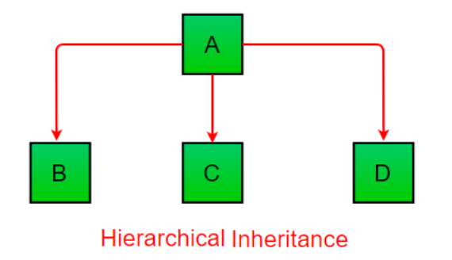
Inheritance
Inheritance in Python is the capability of one class to derive or inherit the properties from another class.
Benefits of Inheritance:
Reusability of code.
We can use the features of the other class, without modifying it.

